Slide 1
Approaches to Autonomous Vehicle Merge Management
Callum Hewitt

Slide 2
Outline
Project Aims
Literature Review
Problem Analysis
Development
Results
Conclusion

Slide 3
Project Aims
Develop and analyse autonomous vehicle methods for merges.
Analyse how the performance of merge management systems are affected by changing merge conditions
Determine how well the AIM simulator codebase is for simulation of AV problems

Slide 4
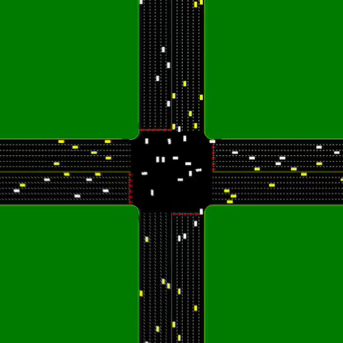
Literature Review
AIM [K. Dresner, P. Stone, 2004]
Centralised System
Efficient use of Space-Time
All autonomous vehicles
Decentralised AIM [M. VanMiddlesworth et al., 2008]
Uses V2V messaging
Cheaper
Other systems
Lane merging based solutions [Atagoziyev, 2016]
Vehicle platooning [Kamali, 2016]
Notes:
AIM
Most important paper
Codebase
Original design based around this
Centralised vs Decentralised
V2I vs V2V communication
Centralised keeps global view of the situation
Fewer messages required
Go into detail later
Decentralised AIM
Uses V2V messaging
Vehicles broadcast Claim and Cancel messages
Claims can dominate other claims
Used effectively as replacements for stop signs
Not used in this paper as you’ll see kater
Other system
Atagoziyev
Developed algorithms for managing vehicles based on their relative positions
Kamali
Vehicle platoons which are big groups of vehicles that move together, accelerating and decelerating at the same rate.
Not talked about either.

Slide 5
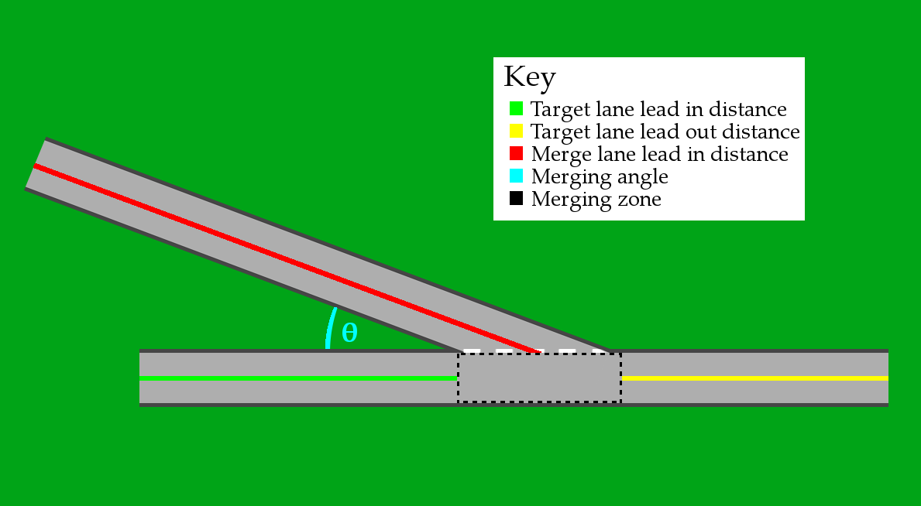
Problem Analysis
Focus on the S2S Merge
Identified a number of merge variance factors
Speed Limits
Traffic Density
Lead in distances
Merge Angle
Identified success variables
Average Delay
Throughput
Solutions
AMM Protocol based on AIM
Decentralised AMM based on VanMiddlesworth’s work.

Slide 6
AMM vs QMM
AMM
QMM
Approaching vehicle sends Request
Arrival Time
Max Velocity/Acceleration/Deceleration
Vehicle Dimensions
Arrival heading
System simulates vehicle journey through an n x n grid of squares representing the merge zone.
If space-time clashes then Reject message sent.
Vehicle continues to make a new reservation
Otherwise vehicle sent a reservation Confirm message and must maintain this reservation or Cancel.
Approaching vehicles send a Request.
VIN
Predecessor vehicle VIN
Distance to Merge
If vehicle is within a set range and predecessor is already in queue vehicle is sent Confirm
Otherwise sent Reject
With a Confirm vehicle waits for a Go. Otherwise vehicle makes another request.
Once sent a Go vehicle moves through the merge zone
Vehicle sends Done once out of the merge zone. System sends a new Go message.

Slide 7

Development
Built on top of the AIM codebase.
Same as “A self-organising approach to autonomous vehicle car park management using a message-based protocol” [Milligan, 2017]
Problems
90° Assumption
Collision prevention not perfect.
QMM Protocol
Queue based system
Fair to each lane
AIM Modification
Notes:
Before we go into detail about the systems we need to talk about development
As mentioned earlier built on top of the AIM codebase, this was a project requirement.
Seemed fine at first until we’d finished work generalising and were towards the finishing end of development.
Problems
90 degrees
Difficulty with shapes used for spawn zones
Would spawn 5 vehicles in the same spot
Collision
One of the bigger surprises
AIM doesn’t detect collisions
Reason is that it doesn’t prevent them very well.
Particularly at high speeds
Fortunately the zones are fine by design but beyond that…
QMM developed to allow simulator to be tested after AMM had too many problems
Aimed to be a simple, fair system.
Likely that we wouldn’t need the full power of AIM.
Created a version of AIM that only takes input on the S and E lanes and outputs on the W lane.

Slide 8
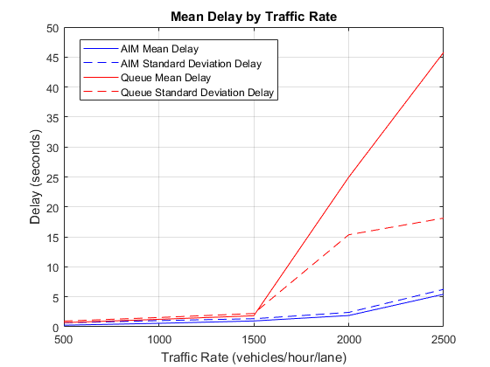
Results – QMM vs AIM
Parameters
20ms^-1 speed limits
90° Merge
150m Lead in distances
Variable traffic density
Delay
Traffic Rate (vhl) | AIM Mean Delay(s) | QMM Mean Delay(s)
1500vhl | 0.97 (1.35 sd.) | 1.84 (2.22 sd.)
2500vhl | 5.43 (6.25 sd.) | 45.78 (18.13 sd.)
Notes:
AIM was clearly better.
Better use of space-time
QMM can only ever have one vehicle in the merge zone - That really starts to take effect after 1500 vhl. Substantaially so.

Slide 9
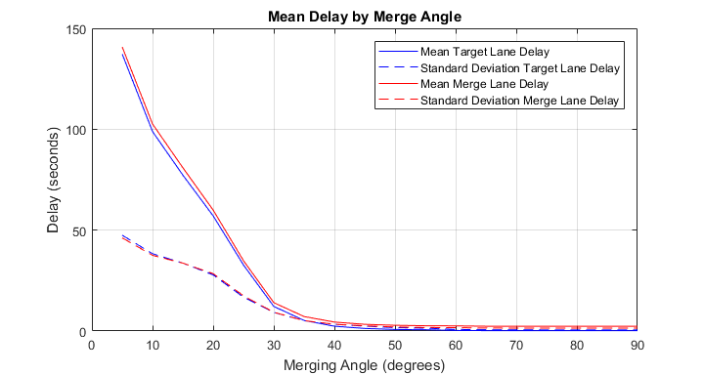
Results – Merge Angle
Parameters
20ms^-1 speed limits
150m Lead in distances
1000 vhl
Delay
Merge Angle | Mean Delay (s) | S.D. (s)
5° | 138.98 | 46.96
30° | 13.12 | 9.35
90° | 1.24 | 1.55
Notes:
Queue Angle
Queue angle has a large effect.
This is because the merge zone length increases dramatically.
Lane width of 4m == 45m merge zone length
So QMM becomes super ineffectual because of the low space-time efficiency.

Slide 10
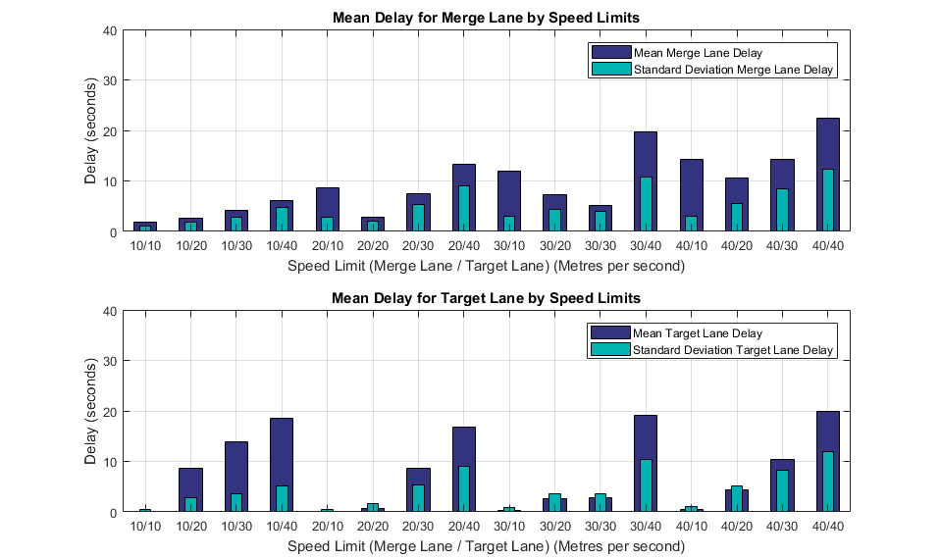
Results – Speed Limits
Parameters
45° Merge
150m Lead in distances
1000 vhl
Pairs of Speed Limits from 10,20,30 and 40 ms^-1.
Delay
Merge Speed L. | Delay Merge | Target Speed L. | Delay Target
30ms^-1 | 12.00 (3.00 sd.) | 10ms^-1 | 0.34 (0.95 sd.)
10ms^-1 | 4.01 (2.87 sd.) | 30ms^-1 | 13.92 (3.56 sd.)
40ms^-1 | 22.42 (12.39 sd.) | 40ms^-1 | 19.86 (11.94 sd.)
Notes:
Speed Limits
Main impact is on the lanes with the fastest speed
Because they’re forced to slow down, their delay takes the biggest hit
This is to be expected, but we shouldn’t expect delays of this magnitude.
Shows that this is an area that good merge systems should be able to deal with.
Perhaps via a progressive braking system
All of AIM just decelerate as hard as possible
40 ms^-1 is just impossible for the system to deal with.

Slide 11
Conclusion
AMM system
QMM system
Merge Angle
Speed Limits
Traffic Rates
AIM codebase
Hidden behaviour and expectations
Incorrect code
Future Work
Fully develop AMM
Decentralised System
Alternative systems
Notes:
AMM System
Results indicate that this system could work well.
By maximising space time efficiency it seems like it could be a good addition.
Obviously we need to prove that it works well under other conditions and doesn’t hit the same pitfalls that QMM does…
QMM
Wasn’t abysmal but wasn’t what we would expect for an autonomous vehicle.
Merge angle had a massive effect -> Introduce slip lanes
Speed limits had a big effect but mainly the differences rather than the speed itself.
Traffic rates, QMM failed here, good systems will have to do well.
AIM codebase
Hidden behaviour and unexpected bugs that are built in because of the initial expectations of the system
Some stuff that was just wrong. Collisions being the big one -> Did not expect that from a professional paper.
Future work
Fully developed AMM system to test under similar conditions -> Possibly in a more generic fresh simulator.
Decentralised system -> Time constraints it was never implemented. Cost benefit is well worth investigating.
Alternative systems
Platooning has a lot of promise
Investigations into early braking systems.

